Slide 1
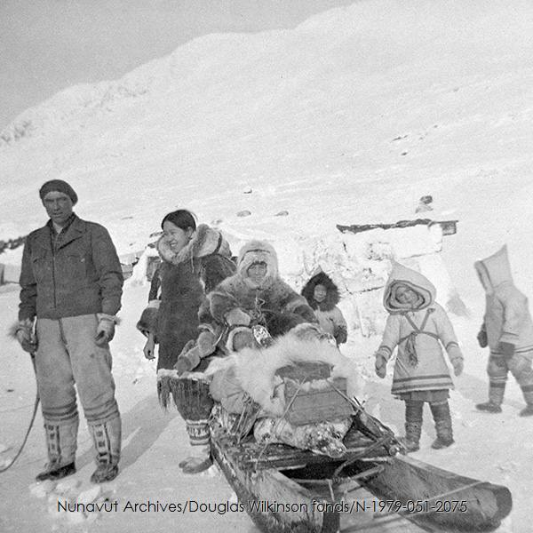
ᐊᔾᔨᓕᐅᕐᓚᒋᑦ
ᐃᓄᐃᑦ ᖃᐅᔨᒪᔭᑐᖃᖏᑦ ᐊᔾᔨᓕᐊᖏᑎᒍᑦ ᔫᓯᐱ ᐃᓪᓚᐅᑦ
ᐅᓇ ᐃᓕᓐᓂᐊᕈᑎ ᓴᕿᑕᖓ ᑖᔅᓱᒪ ᐊᐅᒐᑦᓈᖅ ᐃᒃᑯᔅ, ᐃᓕᓐᓂᐊᕐᕕᒃᔪᐊᒥ ᐃᑦᑕᕐᓂᑕᓕᕆᓂᖅ.
Notes:
ᑕᑯᔭᒐᖃᕐᕕᖕᒥ ᓴᕿᔮᖅᑎᑕᐅᔪᑦ ᓇᓗᓇᐃᔭᖅᓯᒪᖕᒥᖓ ᑖᓐᓇ ᓴᕿᔮᖅᑎᑕᐅᔪᖅ ᑭᓱᒥᒃ ᐱᔾᔪᑎᖃᕐᒪᖔᑦ.

Slide 2
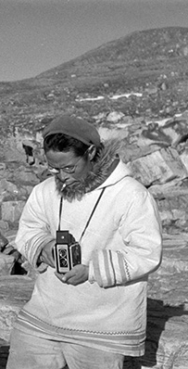
ᔫᓯᐱ ᐃᓪᓚᐅᑦ
ᔪᓯᐱ ᐃᓪᓚᐅᑦ ᓄᓇᓕᖕᓂ ᐊᖓᔪᖅᑳᕆᔭᐅᓚᐅᖅᑐᖅ ᐊᐅᓚᑦᓯᕕᖕᒥ (ᓄᓇᓕᕋᓛᖅ ᓯᓚᑖᓂ ᒥᑦᑎᒪᑕᓕᒃ), ᖃᐅᔨᒪᔭᐅᓚᐅᖅᑐᖅ ᐊᖑᓇᓱᒃᑲᐅᓂᖓᓂᒃ. ᖃᐅᔨᒪᔭᐅᑦᑎᐊᓚᐅᕐᒥᔪᖅ ᐃᓄᒃ 1950-ᓂ ᓴᕿᔮᓚᐅᖅᖢᓂ ᑕᕐᕆᔭᐅᑎᒥ ᐊᑎᖃᖅᑐᖅ “ᓄᓇᖓᑦ ᑖᖅᓯᔪᓐᓇᓐᖏᑦᑐᖅ” ᑕᐃᑲᓂ 1952.

Slide 3
ᖃᓄᐃᓕᖓᓕᕐᓂᕐᒪᑕ ᐃᓄᐃᑦ ᓄᓇᖓ ᑕᐃᔅᓱᒪᓂ? (1950-1960)
ᖁᑎᒃᑐᕐᒥᐅᓄᑦ ᓅᑕᐅᓂᑯᑦ
ᕿᒦᔭᖅᑕᐅᓂᑯᑦ
ᐃᓄᐃᑦ ᓅᑕᐅᑯᑦ ᓄᓇᖃᓕᖅᑎᑕᐅᓪᓗᑎᒃ

Slide 4

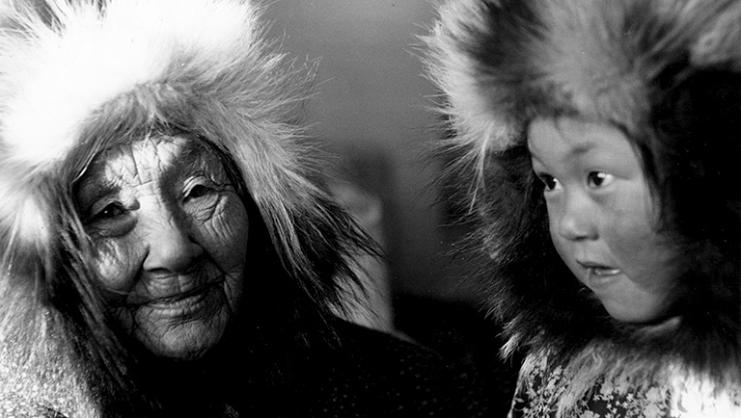
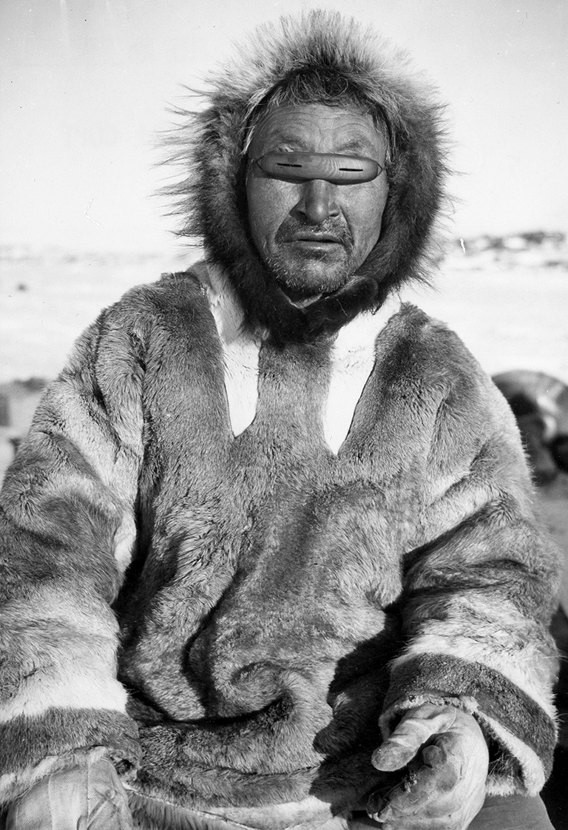
ᐊᔾᔨᖑᐊᖏᑦ ᐃᓄᐃᑦ ᐊᔾᔨᓕᐊᖏᑦ ᖃᓪᓗᓈᑦ
https://www.canadashistory.ca/explore/first-nations-inuit-metis/life-on-the-land
Notes:
Before we dive into the photographs taken by Idlout, I would like to show you guys some photos of Inuit taken by Qallunaat during this time, and some from before, so that we can compare them to the pictures taken by Idlout.

Slide 5
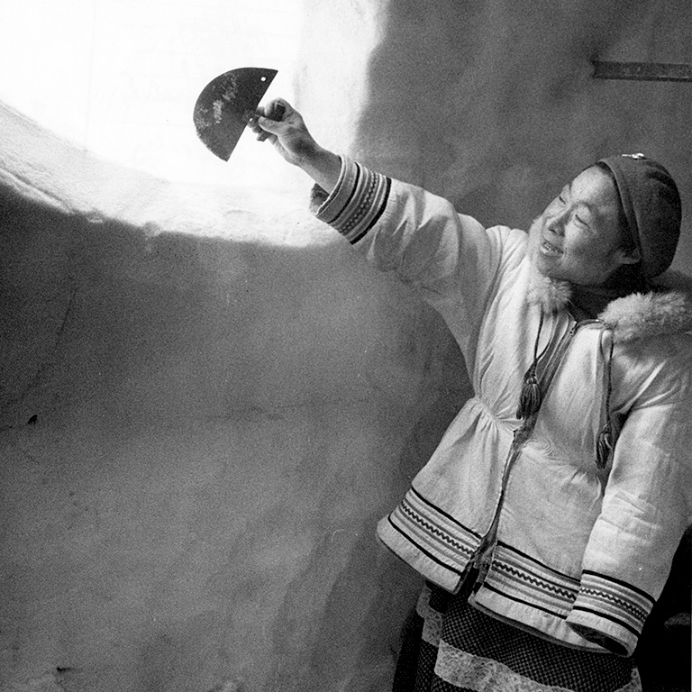
ᐅᓇ [ᐃᓄᒃ] ᐊᕐᓇᖅ ᐊᑎᖃᖅᑐᖅ ᓗᐃᓴ ᐊᐳᑕᐃᔭᐃᔪᖅ ᐃᒐᓛᕐᒥᒃ ᓯᑯᓯᒪᔪᒥᒃ ᐃᓗᐊᓂ ᐃᒡᓗᕕᒐᖅ ᑕᐃᑲᓂ ᐳᕕᖕᓂᑕᒃ, ᐅᓇᓗ ᓄᓇᕘᓕᖅᑐᖅ, ᑕᐃᑲᓂ 1959 ᐊᔾᔨᓕᐊᖓ ᐅᓕᑦᓱᑦ ᕼᐅᓕᖕᑕᓐ.
ᑭᓱᒥᒃ ᑕᑯᕕᑦ ᐅᕙᓂ ᐊᔾᔨᖑᐊᕐᒥ?
ᓇᓕᐊᖕᓂ ᕿᒥᕐᕈᐊᔭᑉᐱᑦ?
ᖃᓄᖅ ᐃᓱᒪᒋᕕᒋᑦ ᐃᓄᐃᑦ ᐊᒻᒪᓗ ᐃᓄᐃᑦ ᐱᐅᓯᑐᖃᖏᑦ?
ᑲᕇᓐ ᑐᕼᐃᒥᐅ “ᐃᓅᓯᖅ ᓄᓇᑐᐃᓐᓇᒥ” ᑲᓇᑕᒥ ᐃᒻᒪᑲᓪᓚᒃ ᐊᑐᖅᑕᐅᓯᒪᔪᑦ. ᓯᑎᐱᕆ 2, 2021
HBCA-1987-363-E-435-016

Slide 6
ᕼᐃᓐᓄᓕ ᐊᑦ-ᓚ-ᑐᐊ ᐊᑐᖅᑐᖅ ᕿᔫᖕᓂ ᐃᒡᒑᖕᓂᒃ ᐊᑐᖅᑕᐅᕙᓚᐅᖅᑐᑦ ᐊᐳᑦ ᖃᐅᓪᓗᕐᓂᖓᓄᑦ ᑕᐅᑦᒍᓐᓃᕐᓂᐊᓐᖏᓐᓇᒥᒃ. ᐊᔾᔨᖑᐊᖅ ᐋᕿᒃᓱᑦᑎᐊᕐᓂᑯᐊ ᔨ.ᕼ. ᒍᐃᑉᓯᑐ, ᐊᐅᐸᓗᒃᑐᓅᖅᑐᖅ ᐊᖕᓕᒃᑲᓐ ᐊᔪᕆᖅᓱᐃᓚᐅᖅᑐᖅ ᑕᓗᕐᔪᐊᖅ, ᓄᓇᑦᓯᐊᖅ 1930-ᓂᑦ 1950-ᓄᑦ. ᐅᓇ ᓴᕿᑎᑕᐅᓂᑯ ᒫᑦᓯ 1949 ᐅᖃᓕᒫᒐᕐᓂ ᐱᔾᔪᑎᓕᑦ ᐃᓅᓯᖅᑕᓕᒃ ᐃᓚᐅᓕᖅᑑᖅ ᐃᒪᖓᓂ ᑖᓐᓇᓗ ᓄᓇᕘᓕᖅᑐᖅ.
ᑭᓱᒥᒃ ᑕᑯᕕᑦ ᐅᕙᓂ ᐊᔾᔨᖑᐊᕐᒥ?
ᖃᓄᖅ ᐃᓕᖕᓂᒃ ᑐᑭᓯᑎᑦᑎᕙ ᐱᔾᔪᑎᒋᓪᓗᒋᑦ ᐃᓄᐃᑦ ᐊᒻᒪᓗ ᐃᓄᐃᑦ ᐱᐅᓯᑐᖃᖏᑦ?
ᑲᕇᓐ ᑐᕼᐃᒥᐅ “ᐃᓅᓯᖅ ᓄᓇᑐᐃᓐᓇᒥ” ᑲᓇᑕᒥ ᐃᒻᒪᑲᓪᓚᒃ ᐊᑐᖅᑕᐅᓯᒪᔪᑦ. ᓯᑎᐱᕆ 2, 2021.
HBCA-1987-363-E-152-004A

Slide 7
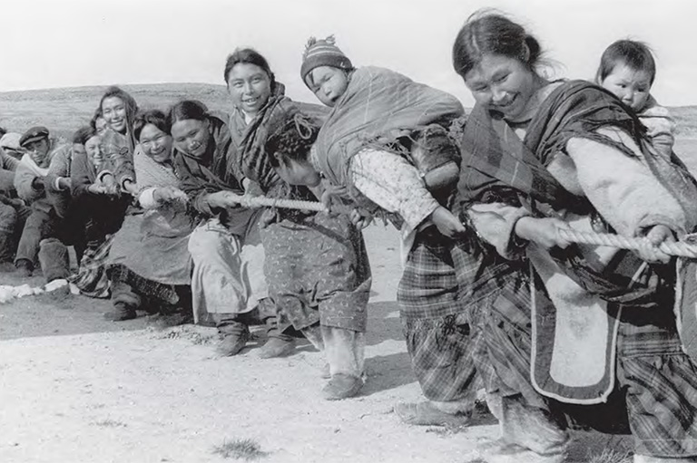
ᐃᓚᒋᔭᐅᔪᑦ ᐃᓄᖕᓂᑦ ᓄᓇᖓ ᐊᑎᖃᓐᖏᑦᑐᖅ
ᓄᓱᒃᓯᓇᓱᒃᑐᑦ ᐱᓐᖑᐊᖅᖢᑎᒃ 1934 ᐊᔾᔨᖑᐊᖅ ᐊᔾᔨᓕᐊᖓ ᕼ. ᐸᓯᑦ
ᑭᓱᒥᒃ ᑕᑯᕕᑦ ᐅᕙᓂ ᐊᔾᔨᖑᐊᕐᒥ?
ᖃᓄᖅ ᐃᓕᖕᓂᒃ ᑐᑭᓯᑎᑦᑎᕙ ᐱᔾᔪᑎᒋᓪᓗᒋᑦ ᐃᓄᐃᑦ ᐊᒻᒪᓗ ᐃᓄᐃᑦ ᐱᐅᓯᑐᖃᖏᑦ?
ᑲᕇᓐ ᑐᕼᐃᒥᐅ “ᐃᓅᓯᖅ ᓄᓇᑐᐃᓐᓇᒥ” ᑲᓇᑕᒥ ᐃᒻᒪᑲᓪᓚᒃ ᐊᑐᖅᑕᐅᓯᒪᔪᑦ. ᓯᑎᐱᕆ 2, 2021
HBCA-1987-363-E-220-042

Slide 8
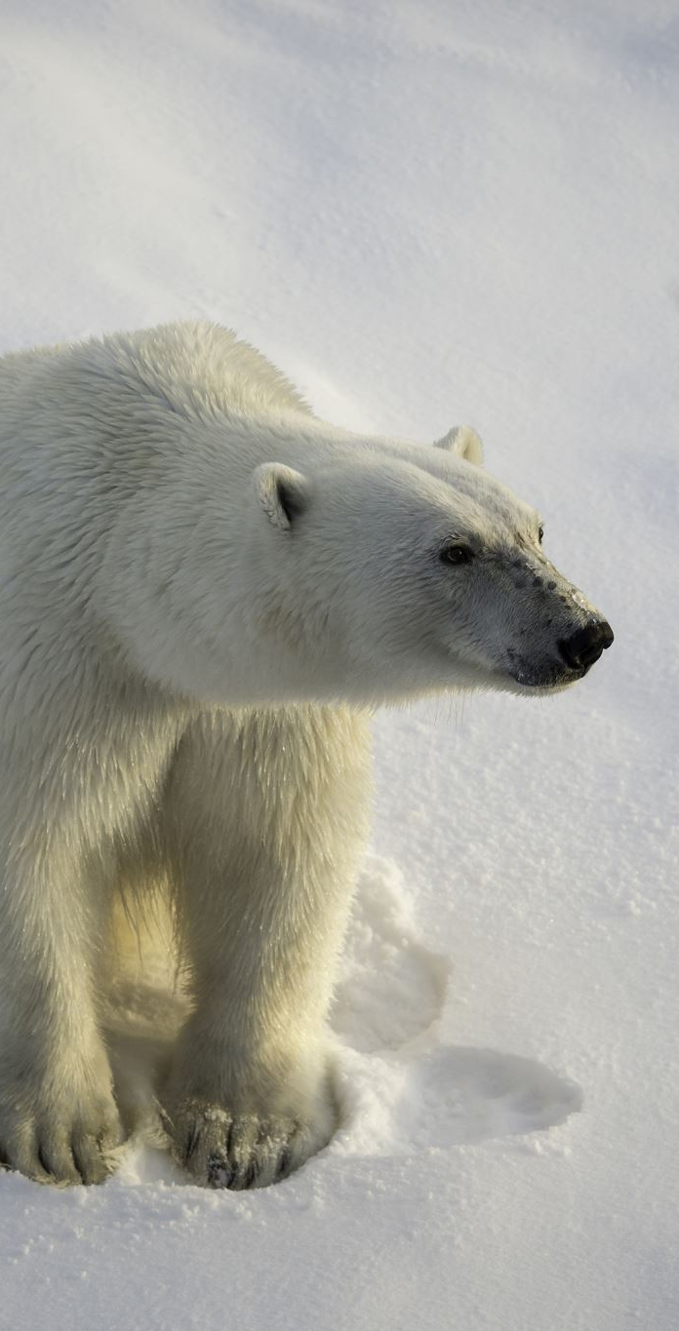
ᐃᓄᐃᑦ ᖃᐅᔨᒪᔭᑐᖃᖏᑦ
ᑭᓲᕙᑦ ᐃᓄᐃᑦ ᖃᐅᔨᒪᔭᑐᖃᖏᑦ?
ᖃᓄᐃᒻᒪᑦ ᐱᒻᒪᕆᐅᕙᑦ?

Slide 9
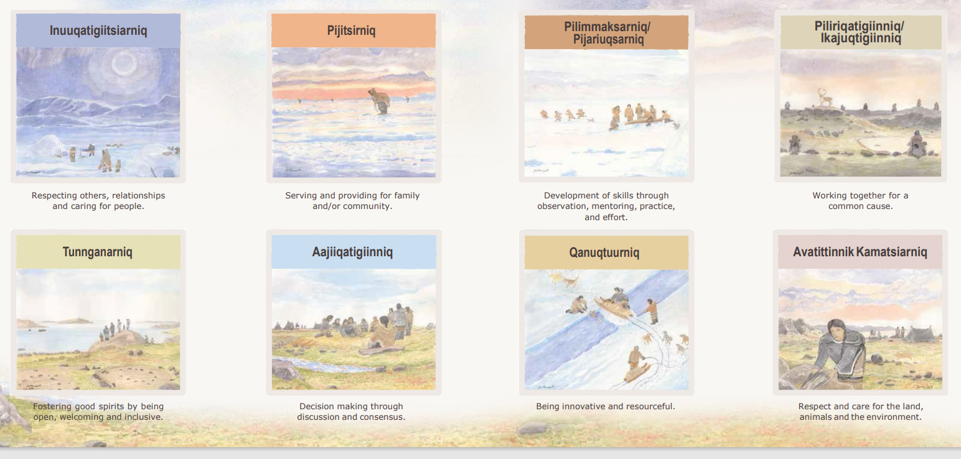
Notes:
ᐃᓅᖃᑎᒌᑦᓯᐊᕐᓂᖅ-ᐃᒃᐱᒋᑦᑎᐊᕐᓗᒋᑦ ᐊᓯᑎᑦ, ᐃᓚᒌᒍᓯᖅ ᐊᒻᒪᓗ ᐸᕿᑦᑎᐊᕐᓂᖅ ᐃᓄᖕᓂᒃ. ᐱᔨᑦᓯᕐᓂᖅ- ᐱᔨᑦᓯᕋᖅᑐᖅ ᐊᒻᒪᓗ ᑐᓂᓯᓯᒪᔪᖅ ᐃᓚᒌᓄᑦ ᐊᒻᒪᓗ/ᐅᕝᕙᓘᓐᓃᑦ ᓄᓇᓕᖕᓄᑦ. ᐱᓕᒻᒪᒃᓴᕐᓂᖅ/ᐱᔭᕆᐅᖅᓴᓂᖅ - ᐱᕙᓪᓕᐊᑎᑦᑎᓂᖅ ᓴᓇᔪᓐᓇᖅᓯᓂᐊᕐᒪᑕ ᑕᐅᑐᒃᓗᑎᒃ, ᐃᓕᓐᓂᐊᖅᑎᑕᐅᓗᑎᒃ, ᐱᔭᕆᐅᖅᓴᓗᑎᒃ ᐊᒻᒪᓗ ᐊᔪᕈᓐᓃᖅᓴᓗᑎᒃ. ᐱᓕᕆᖃᑎᒌᖕᓂᖅ/ᐃᑲᔪᖅᑎᒌᖕᓂᖅ - ᓴᓇᖃᑎᒌᒡᓗᑎᒃ ᐱᔭᕇᓂᐊᕐᒪᑕ. ᑐᓐᖓᓇᕐᓂᖅ - ᐊᑐᖅᓯᔪᖅ ᐃᓄᑦᑎᐊᕙᐅᓪᓗᓂ ᒪᑐᐃᖓᑦᑎᐊᖅᖢᓂ, ᑐᓐᖓᓇᖅᑐᖅ ᐊᒻᒪᓗ ᐃᓚᐅᔾᔨᓯᒪᑦᑎᐊᖅᑐᖅ. ᐋᔩᖃᑎᒌᖕᓂᖅ- ᐃᓱᒪᓕᐅᕆᓂᖅ ᑕᒪᐅᓐᓇ ᐅᖃᖃᑎᒌᒡᓗᑎᒃ ᐊᒻᒪᓗ ᐊᖏᖃᑎᒌᒡᓗᑎᒃ. ᖃᓄᖅᑑᕐᓂᖅ - ᐱᓕᕆᑦᑎᐊᕈᑎᒃᓴᓄᑦ ᐊᒻᒪᓗ ᐃᑲᔫᑎᒃᓴᓄᑦ. ᐊᕙᑎᑦᑎᓂᒃ ᑲᒪᑦᓯᐊᕐᓂᖅ - ᐃᒃᐱᒋᑦᑎᐊᕐᓗᒋᑦ ᐊᒻᒪᓗ ᐸᕿᑦᑎᐊᕐᓗᒋᑦ ᓄᓇ, ᓂᕐᔪᑎᑦ ᐊᒻᒪᓗ ᐅᕙᑎ.

Slide 10
ᐃᓄᐃᑦ ᖃᐅᔨᒪᔭᑐᖃᖏᑦ
ᐃᓄᐃᑦ ᖃᐅᔨᒪᔭᑐᖃᖏᑦ ᓇᓗᓇᐃᖅᓯᔾᔪᑕᐅᕙᒃᑐᑦ ᖃᓄᑐᐃᓐᓇᑦᑎᐊᖅ ᑭᓯᐊᓂᓕ ᑐᑭᓯᐅᒪᔭᐅᔪᑦ ᖃᐅᔨᒪᑎᑕᐅᒐᒥᒃ ᓯᕗᓕᑐᖃᕆᓚᐅᖅᑕᑦᑎᓐᓂᑦ ᒫᓐᓇᒧᑦ.
ᔭᐃᐱᑎ ᐊᕐᓇᒃᑲ ᓇᓗᓇᐃᑦᑎᐊᓚᐅᖅᑕᖓ ᐃᓄᐃᑦ ᖃᐅᔨᒪᔭᑐᖃᖓ ᐃᒪᓐᓇ, ”ᐅᓇ [ᐊᑐᖅᑕᐅᓲᖅ] ᐋᕿᒃᓲᑕᐅᓪᓗᓂ ᐃᓱᒪᒧᑦ ᐊᒻᒪᓗ ᐱᓕᕆᓂᒃᑯᑦ, [ᐊᑐᖅᑕᐅᓲᖅ] ᐋᕿᒃᓱᐃᔾᔪᑕᐅᓪᓗᓂ ᐱᔭᒃᓴᓂᒃ ᐊᒻᒪᓗ ᐃᑲᔫᑎᒃᓴᓂᒃ ᐃᓚᒌᓄᑦ ᐊᒻᒪᓗ ᓄᓇᖃᑎᒌᖕᓄᑦ [ᑲᑎᑦᑎᐊᕐᓂᐊᕐᒪᑕ].”
ᐃᓐᓇᑐᖃᖅ ᒥᐊᓕᐊᓄ ᐊᐅᐱᓛᕐᔪᒃ ᓇᓗᓇᐃᑦᑎᐊᓚᐅᖅᑕᖓ ᐃᓄᐃᑦ ᖃᐅᔨᒪᔭᑐᖃᖓ ᐃᒪᓐᓇ ᐅᖃᖅᖢᓂ, “[ᐃᓄᐃᑦ ᖃᐅᔨᒪᔭᑐᖃᖓ] ᒪᓕᒃᑐᖅ ᓱᓕᔪᓂᒃ ᐃᓄᐃᑦ ᐱᐅᓯᖏᓐᓂᒃ ᐊᒻᒪᓗ ᐃᓅᖃᑎᒌᑦᑎᐊᕐᓂᐊᕋᒥᒃ. ᓄᓇᖃᑎᒌᑦᑎᐊᕐᓗᑎᒃ ᑕᐃᒫᒃᑕᐅᖅ ᓂᕆᐅᒋᔭᑦᑎᒍᑦ ᓯᓚᕐᔪᐊᑦᑎᓃᑦᑐᑦ ᐅᕙᑦᑎᓐᓂᒃ ᐊᕙᓗᓯᓯᒪᔪᑦ.”

Slide 11
Why organize an exhibition through Inuit Qaujimajatuqangit ᖃᓄᐃᒻᒪᑦ ᐋᕿᒃᓱᐃᓯᒪᕕᑖ ᑕᑯᔭᒃᓴᕈᖅᑎᓯᒪᓪᓗᒋᑦ ᐃᓄᐃᑦ ᖃᐅᔨᒪᔭᑐᖃᖏᑦ?

Slide 12
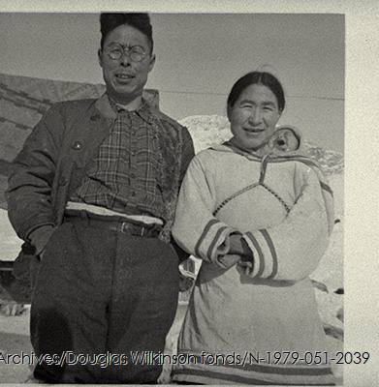
ᐃᓪᓚᐅᑦ ᐊᔾᔨᓕᐊᖏᖅ
ᐅᓇ ᐊᔾᔨᖑᐊᖓ ᐊᔾᔨᓕᐊᖓ ᐃᓪᓚᐅᑦ ᐊᒻᒪᓗ ᑐᓂᔭᐅᓯᒪᔪᖅ ᑕᑯᒃᓴᐅᑎᑦᑎᕕᒋᔭᑦᑎᓐᓄᑦ ᓂᕈᐊᕆᓯᒪᓪᓗᓂᐅᒃ ᑕᒃᓕᔅ ᒍᐃᑭᓐᓴᓐ ᐃᓂᓕᐅᖅᓯᒪᔭᖏᑦ ᓄᓇᕗᑦ ᐃᑦᑕᕐᓂᑕᖏᓐᓄᑦ.

Slide 13
ᐃᑲᔪᖅᑎᒌᖕᓂᖅ
ᓴᓇᖃᑎᒌᒡᓗᑎᒃ ᐱᕇᓂᐊᕐᒪᑕ

Slide 14
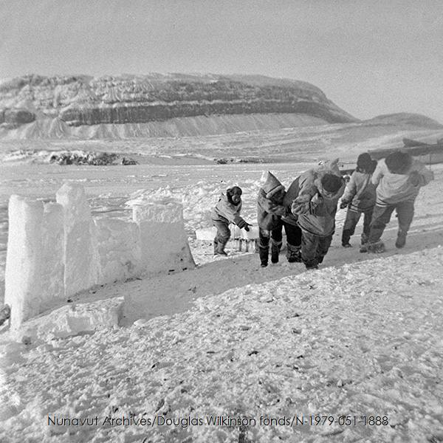

Slide 15
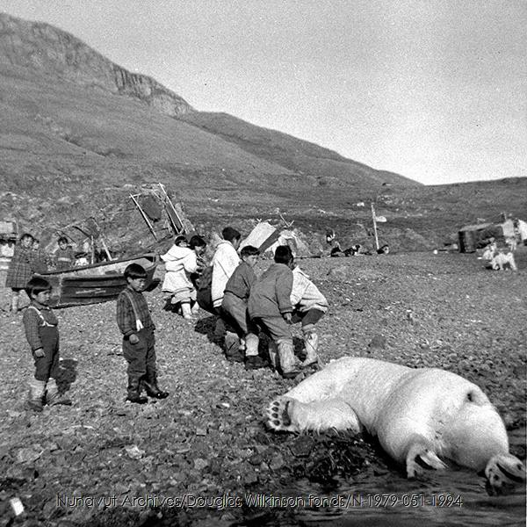

Slide 16
ᐱᓕᒻᒪᒃᓴᕐᓂᖅ
ᐱᕙᓪᓕᐊᑎᑦᑎᓂᖅ ᓴᓇᔪᓐᓇᖅᓯᓂᐊᕐᒪᑕ ᑕᐅᑐᒃᓗᑎᒃ, ᐃᓕᓐᓂᐊᖅᑎᑕᐅᓗᑎᒃ, ᐱᔭᕆᐅᖅᓴᓗᑎᒃ ᐊᒻᒪᓗ ᐊᔪᕈᓐᓃᖅᓴᓗᑎᒃ.

Slide 17
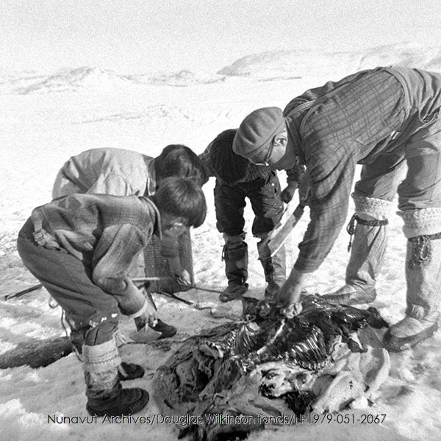

Slide 18
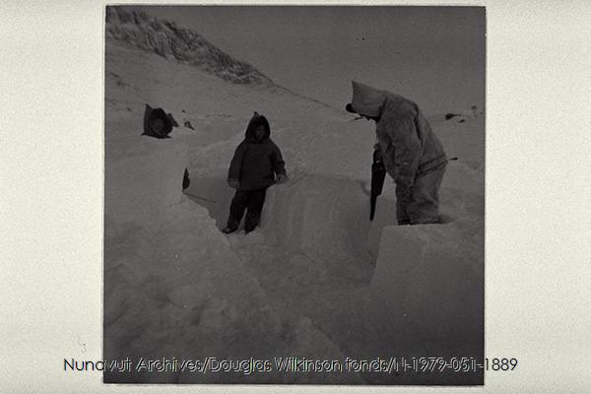

Slide 19
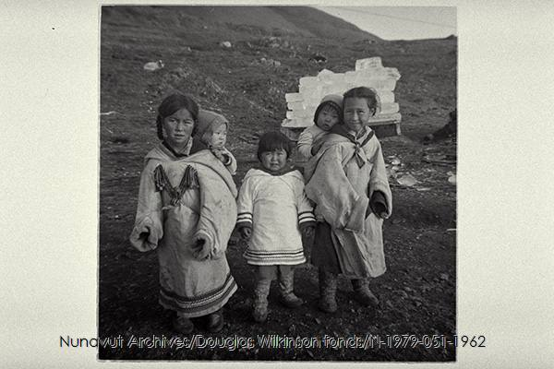

Slide 20
ᖃᓄᖅᑑᕐᓂᖅ
ᐱᓕᕆᑦᑎᐊᕈᑎᒃᓴᓄᑦ ᐊᒻᒪᓗ ᐃᑲᔫᑎᓴᓄᑦ.

Slide 21
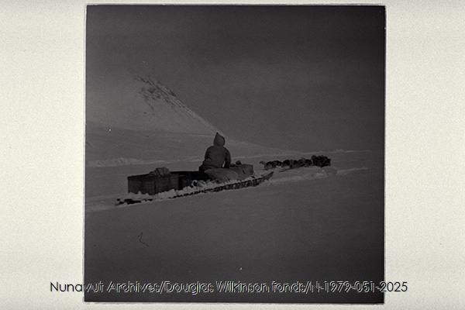

Slide 22
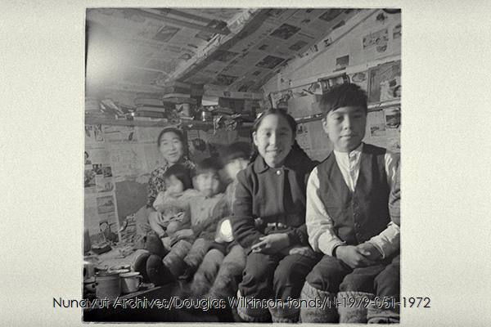

Slide 23
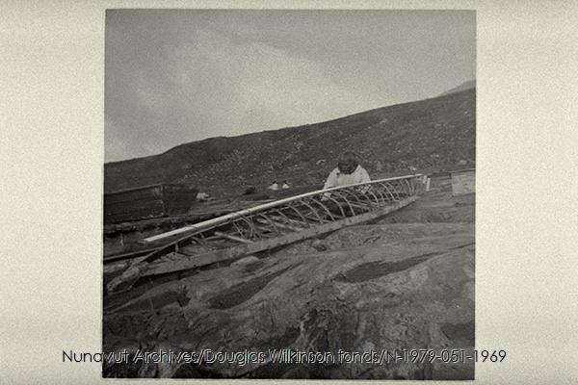

Slide 24
ᐃᓅᖃᑎᒌᑦᓯᐊᕐᓂᖅ
ᐃᒃᐱᒋᑦᑎᐊᕐᓗᒋᑦ ᐊᓯᑎᑦ, ᐃᓚᒌᒍᓯᖅ ᐊᒻᒪᓗ ᐸᕿᑦᑎᐊᕐᓂᖅ ᐃᓄᖕᓂᒃ

Slide 26
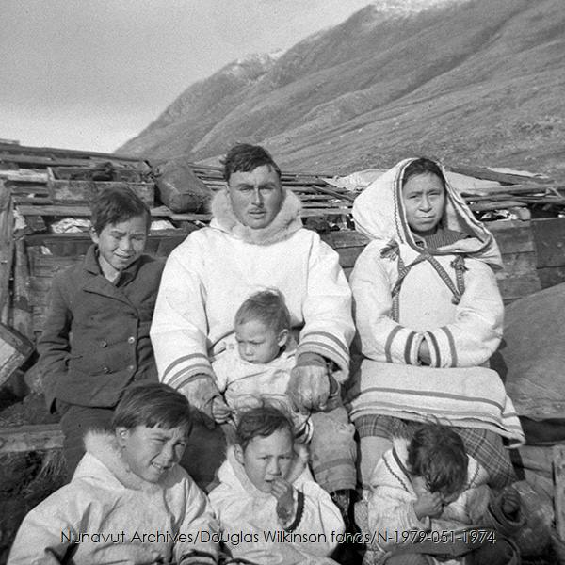

Slide 27
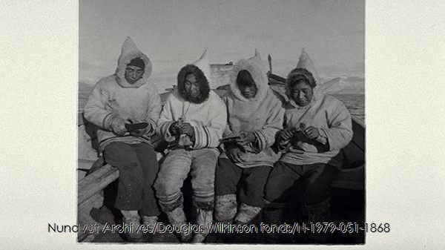

Slide 28
ᐃᓱᓕᑉᐳᒍᑦ ᐅᖃᖃᑎᒌᒍᑕᐅᔪᑦ ᐊᐱᖁᑎᖏᓐᓂᒃ:
ᓇᓕᐊᒃ ᐊᔾᔨᖑᐊᓂ ᐱᐅᒋᓛᕆᕕᐅᒃ ᑕᑯᒃᓴᐅᑎᑕᑦᑎᓐᓂᑦ?
ᖃᓄᐃᓕᖓᖕᒪᑦ ᐱᐅᒋᕕᐅᒃ?
ᖃᓄᑐᐃᓐᓇᖅ ᐃᓱᒪᖃᕈᕕᑦ ᐱᔾᔪᑎᒋᓪᓗᒋᑦ ᑖᒃᑯᐊ ᐅᖃᐅᓯᕆᔭᕗᑦ.

Slide 29
ᓴᓇᑦᑎᐊᖅᓯᒪᓗᒍ
ᑭᐅᔾᔪᑏᑦ:
ᓂᕈᐊᕐᓗᑎᑦ ᐊᑕᐅᓯᕐᒥᒃ ᐃᓄᐃᑦ ᖃᐅᔨᒪᔭᑐᖃᖏᓐᓂᑦ ᑐᓐᖓᔾᔪᑕᐅᔪᓂᒃ ᑖᓐᓇᓗ ᐃᓕᖕᓄᑦ ᐊᑕᔪᖅ ᐊᒻᒪᓗ ᐊᔾᔨᓕᐅᕆᓗᑎᑦ ᑕᑯᑎᑦᑎᔪᒥᒃ ᑐᓐᖓᔾᔪᑕᐅᔪᖅ ᐊᑐᖅᑕᐅᑎᓪᓗᒍ.

Slide 30
ᐃᑲᔪᖅᑐᑦ ᐃᓕᓴᕆᔭᕗᑦ
ᑲᕇᓐ ᑐᕼᐃᒥᐅ “ᐃᓅᓯᖅ ᓄᓇᑐᐃᓐᓇᒥ” ᑲᓇᑕᒥ ᐃᒻᒪᑲᓪᓚᒃ ᐊᑐᖅᑕᐅᓯᒪᔪᑦ. ᓯᑎᐱᕆ 2, 2021. ᐱᒃᓴᐅᔪᖅ ᖃᕆᓴᐅᔭᒃᑯᖅ ᐅᕘᓇ https://www.canadashistory.ca/explore/first-nations-inuit-metis/life-on-the-land
ᕼᐃᑐ ᑲᓐᐳ, “ᑐᓐᓃᑦ/ᑲᒃᑭᓃᑦ ᐱᔭᕐᓂᓐᖏᑦᑐᑦ ᐊᑐᖅᑕᐅᓚᐅᖅᓯᒪᔪᕕᓃᑦ ᐊᔾᔨᓕᐊᖏᑦ ᐃᓄᐃᑦ ᑐᓂᖏᑦ" ᐅᖃᓕᒫᒐᖃᕐᕕᖕᒥᑦ ᐊᒻᒪᓗ ᐃᑦᑕᕐᓂᑕᖃᕐᕕᖕᒥ ᑲᓇᑕ ᑎᑎᕋᖅᑕᐅᓯᒪᔪᖅ. ᔮᓄᐊᕆ 14, 2021. ᐱᒃᓴᐅᔪᖅ ᖃᕆᓴᐅᔭᒃᑯᖅ ᐅᕘᓇ https://thediscoverblog.com/2021/01/14/tunniit-tattoos-the-complicated-history-of-photographing-inuit-tattoos/
ᐃᓪᓚᐅᑉ ᐊᔾᔨᓕᐊᖏᖅ ᑖᔅᓱᒪᖓᑦ ᐱᔭᐅᔪᑦ ᑕᒃᓕᔅ ᒍᐃᑭᓐᓴᓐ (ᓄᓇᕗᒻᒥ ᐃᑦᑕᕐᓂᑕᐃᑦ ᑭᓯᐊᓂ ᒫᓐᓇ ᐃᓂᖃᖅᑐᑦ ᓄᓇᑦᓯᐊᖅ ᐃᑦᑕᕐᓂᑕᖃᕐᕕᖓᓂ)

